Slide 1
Longest Job First (LJF) CPU Scheduling Algorithm
Longest Job First (LJF) is a non-preemptive scheduling algorithm. This algorithm is based on the burst time of the processes. The processes are put into the ready queue based on their burst times i.e., in descending order of the burst times. As the name suggests this algorithm is based on the fact that the process with the largest burst time is processed first. The burst time of only those processes is considered that have arrived in the system until that time. Its preemptive version is called Longest Remaining Time First (LRTF) algorithm.
Example-1: Consider the following table of arrival time and burst time for four processes P1, P2, P3 and P4.

Slide 2
At time = 1, Available Process : P1. So, select P1 Time and start executing.
Time Instance | Process | Arrival Time | Waiting Table | Execution Time | Initial Burst Time | Remaining Burst Time
1-2ms | P1 | 1ms |  | 1ms | 2ms | 1ms
At time = 2, Process P2 arrives , As P1 is executing thus, Process P2 will wait in the waiting queue.
Time Instance | Process | Arrival Time | Waiting Table | Execution Time | Initial Burst Time | Remaining Burst Time
2-3ms | P1 | 1ms | P2 | 1ms | 1ms | 0ms
 | P2 | 2ms |  | 0ms | 4ms | 4ms
At time = 3, P1 gets executed, and process P3 arrives,
Available Process: P2, P3. So, select P3 and execute 6 ms (since B.T(P3)=6 which is higher than B.T(P2) = 4)
Time Instance | Process | Arrival Time | Waiting Table | Execution Time | Initial Burst Time | Remaining Burst Time
3-4ms | P2 | 2ms | P2 | 0ms | 4ms | 4ms
 | P3 | 3ms |  | 1ms | 6ms | 5ms
At time = 4, Process P4 arrives, As P3 is executing thus, Process P4 will wait in the waiting queue
Time Instance | Process | Arrival Time | Waiting Table | Execution Time | Initial Burst Time | Remaining Burst Time
4-5ms | P2 | 2ms | P2, P4 | 0ms | 4ms | 4ms
 | P3 | 3ms |  | 1ms | 5ms | 4ms
 | P4 | 4ms |  | 0ms | 8ms | 8ms

Slide 3
At time = 5, Process P3 is executing and P2 and P4 are in the waiting Table.
Time Instance | Process | Arrival Time | Waiting Table | Execution Time | Initial Burst Time | Remaining Burst Time
5-9ms | P2 | 2ms | P2, P4 | 0ms | 4ms | 4ms
 | P3 | 3ms |  | 4ms | 4ms | 0ms
 | P4 | 4ms |  | 0ms | 8ms | 8ms
At time = 9, Process P3 completes its execution,
Available Process : P2, P4. So, select P4 and execute 8 ms (since, B.T(P4) = 8, B.T(P2) = 4)
Time Instance | Process | Arrival Time | Waiting Table | Execution Time | Initial Burst Time | Remaining Burst Time
9-17ms | P2 | 2ms | P2 | 0ms | 4ms | 4ms
 | P4 | 4ms |  | 8ms | 8ms | 0ms
At time = 17, Finally execute the process P2 for 4 ms.
Time Instance | Process | Arrival Time | Waiting Table | Execution Time | Initial Burst Time | Remaining Burst Time
17-21ms | P2 | 2ms |  | 4ms | 4ms | 0ms
At time = 21, Process P2 will finish its execution.

Slide 4

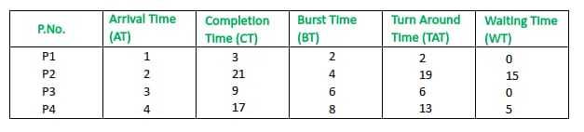
CPU will be idle for 0 to 1 unit time since there is no process available in the given interval.
Gantt chart will be as following below:
Turn Around Time (TAT) = (Completion Time) - (Arrival Time)
Waiting Time (WT) = (Turn Around Time) - (Burst Time
Total Turn Around Time = 40 ms
So, Average Turn Around Time = 40/4 = 10.00 ms
And, Total Waiting Time = 20 ms
So, Average Waiting Time = 20/4 = 5.00 ms

Slide 5
Advantages of Longest Job First(LJF)
No other process can execute until the longest job or process executes completely.
All the jobs or processes finish at the same time approximately.
Disadvantages of Longest Job First CPU Scheduling Algorithm
This algorithm gives a very high average waiting time and average turn-around time for a given set of processes.
This may lead to a convoy effect.
It may happen that a short process may never get executed and the system keeps on executing the longer processes.
It reduces the processing speed and thus reduces the efficiency and utilization of the system.

Slide 6
Highest Response Ratio Next (HRRN) CPU Scheduling
One of the most optimal scheduling algorithms is the Highest Response Ratio Next (HRNN). This algorithm is a non-preemptive algorithm in which, HRRN scheduling is done based on an extra parameter, which is called Response Ratio. Given N processes with their Arrival times and Burst times, the task is to find the average waiting time and an average turnaround time using the HRRN scheduling algorithm.
The name itself states that we need to find the response ratio of all available processes and select the one with the highest Response Ratio. It is designed to improve upon simpler algorithms like First-Come-First-Serve (FCFS) and Shortest Job Next (SJN) by balancing both the waiting time and the burst time of processes.

Slide 7
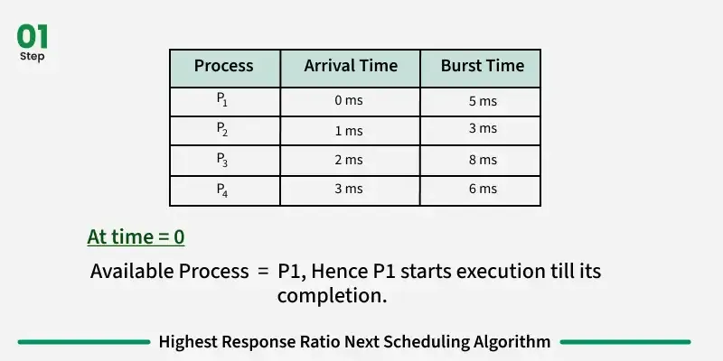

Slide 8
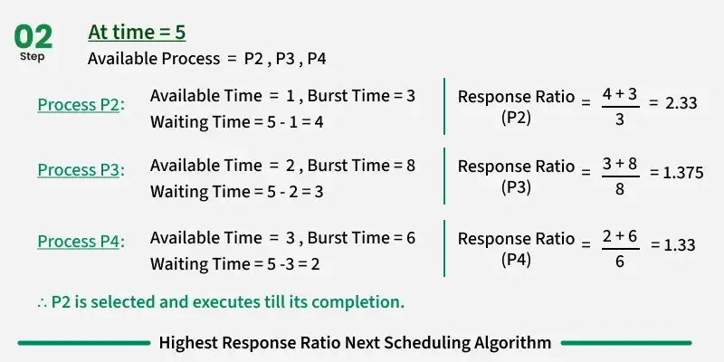

Slide 9
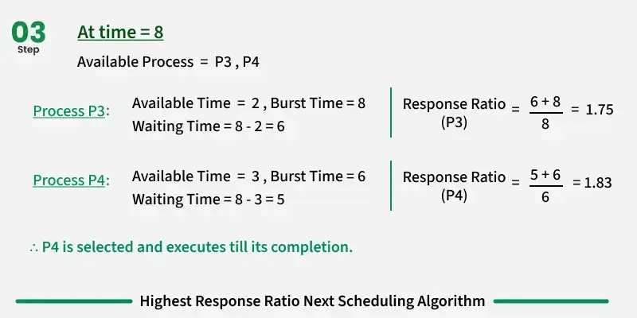

Slide 10
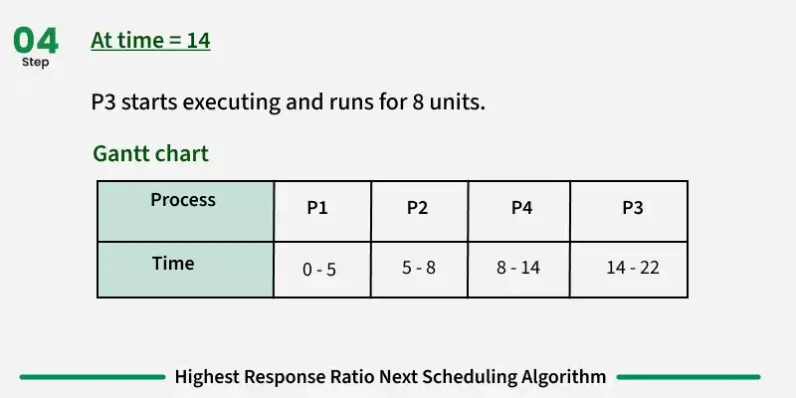

Slide 12
Average Turnaround Time (TAT):
Average TAT=TAT₁+TAT₂+TAT₃+TAT₄/4 = 5+7+11+20/4 = 43/4 = 10.75
Average Waiting Time (WT):
Average WT=WT₁+WT₂+WT₃+WT₄/4 = 0+4+5+12/4 = 21/4 = 5.25

